Slide 1
Multiple QBITS
Dr. Bhawana Rudra
NITK

Slide 2
single qubits are denoted as |0>, |1>, or any generic state |𝜓 > .
denote two qubits, we use the notation |00>, |11>, or any generic state, such as |𝜓 𝜙 > .
Two different quantum subsystems, each having their own vector spaces.
Their interactions can be denoted by the addition and scalar multiplication of the vector elements, which we usually denote as 𝜓⨂𝜙,which is the tensor product of the quantum systems 𝜓 and 𝜙.
Consider |1> ⨂ |1>,

Slide 3
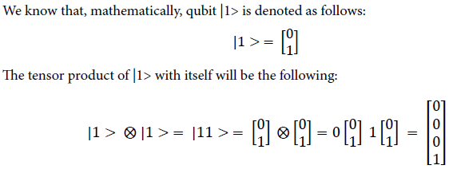
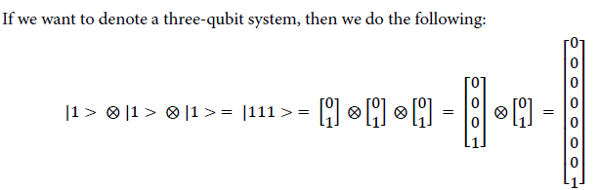

Slide 4
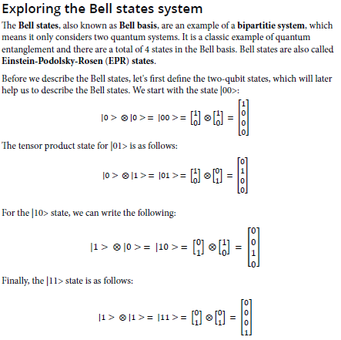

Slide 5

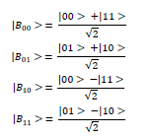

Slide 6
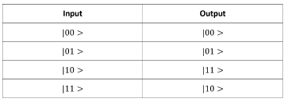
The quantum CX or CNOT gate
The CNOT or the CX gate is one of the most important quantum gates utilized in quantum computing to create entanglement.
The C in CNOT is known as Controlled.
This gate is also known as a conditional bit flip gate because, as we will see, it flips the bit when a certain condition is met.
This gate acts on two qubits, which can have quantum states 𝜓 and 𝜙 , where 𝜓 is the control qubit and 𝜙 is the target qubit.

Slide 7
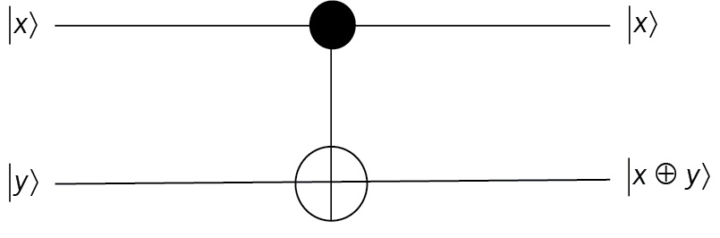
The CX gate is performing an XOR operation on the target qubit and therefore is equivalent to the XOR gate you might know from classical logic gate theory.
This means that if you take the control qubit as x and target qubit as y, then essentially a CNOT gate is performing an addition modulo 2 operation on the target qubit as 𝑥 ⊕ 𝑦 , and this is the main reason for the XOR being applied by the CNOT.
The |x> qubit is the control qubit and the |y> qubit is the target.
The control is represented as a dot and then you can see the symbol for the XOR operation in the second qubit.

Slide 8
The advantage we receive here is that the number of inputs and outputs in CX is the same, which helps to preserve the reversible nature of quantum gates.
On the other hand, classical XOR does not have a reversible nature because the number of inputs and outputs are not the same.

Slide 9
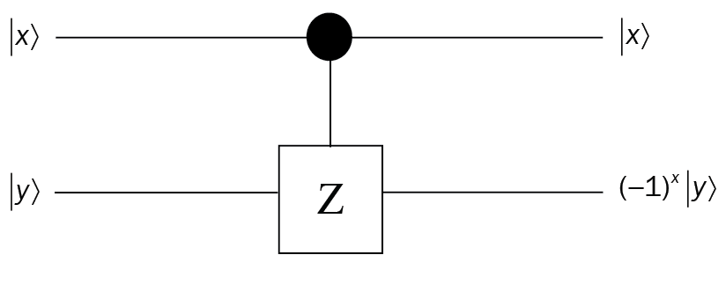
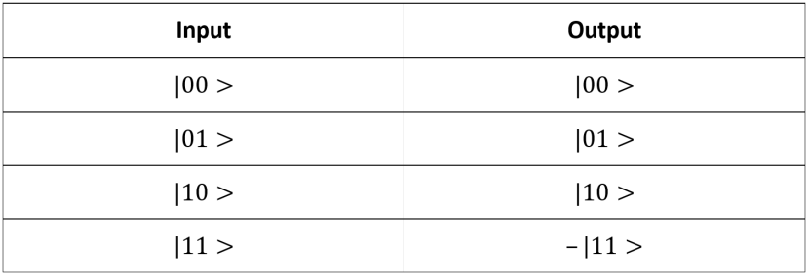
The quantum CZ or CPHASE gate
The quantum CZ gate is the controlled Z gate operation similar to the CNOT gate.
we studied now. This gate is also known as the CPHASE gate.
Here, the first qubit will control and the second qubit will be the target with a Z operation.
we get the −|11 > state in the end. For all the other states, CZ does nothing because CZ requires the control qubit to be 1 to operate and the target qubit to be 1 as well to reflect the phase changes.
In essence, the CZ gate multiplies the phase (−1)^{x} by the target qubit, where x is the value of the control qubit.

Slide 10

The |x> qubit is the control qubit and the |y> qubit is the target.
The control is represented as a dot and then you can see the symbol for Z operation in the second qubit and the output we get is (−1)^{x}|𝑦 > in the target qubit.
CZ matrix that the top-left quadrant is a 2x2 identity matrix and the bottom right quadrant is the matrix for the Pauli Z gate.

Slide 11
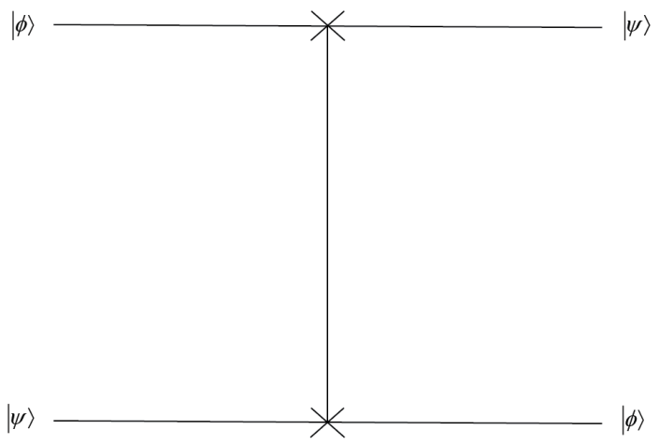
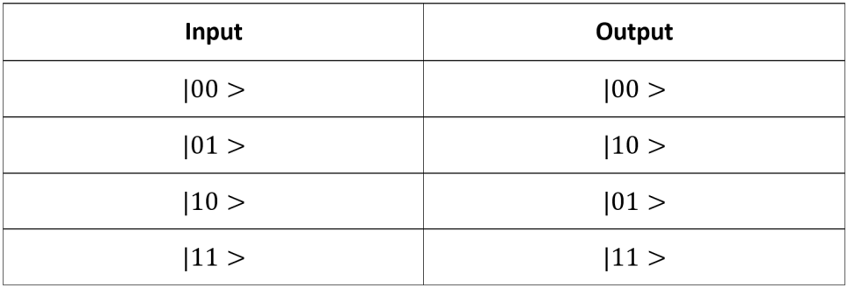

The quantum SWAP gate
Two cross marks have been put into the qubit states |𝜙> and |𝜓 > and they have been interchanged due to the SWAP operation

Slide 12
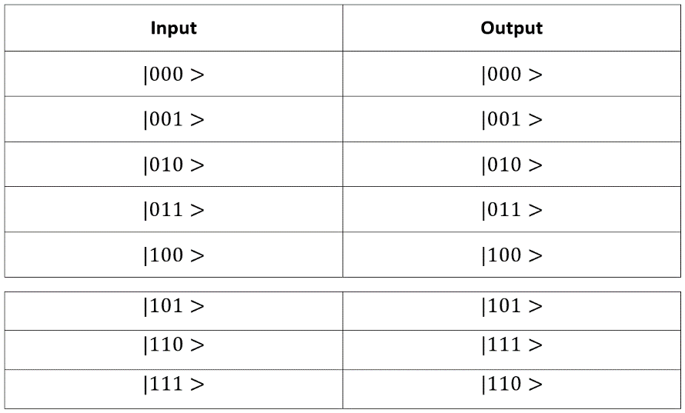
The quantum CCX or CCNOT gate – Toffoli gate
The CCNOT gate is a three-qubit quantum gate and is known as the Controlled-Controlled NOT gate. The CCX gate is also known as the Toffoli gate (named after Tommaso Toffoli).
As you might have already guessed from the name, this gate has the first and second qubits as the control and the third qubit as the target. The matrix in the three-qubit case will be 8x8 (2³x2³ )
you can see that when the first and second qubits (control qubits) become 1, only then is the X gate operation applied to the third qubit (the target qubit) and the target qubit is flipped.
The output on the CCNOT gate can be considered as the AND or the NAND classical logic gate operation.

Slide 13
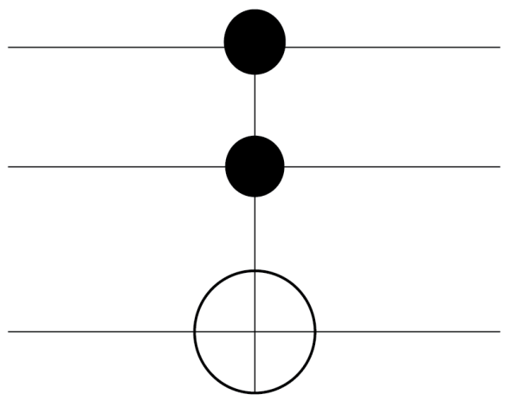
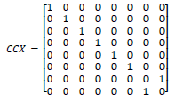
you can see that the first two qubits are the controls and the third qubit is the target qubit where the operation is applied.
you can see that the upper-left quadrant of 4x4 is the identity operation and the lower-right quadrant of 4x4 is the controlled NOT operation, which verifies that this is the CCX gate matrix

Slide 14
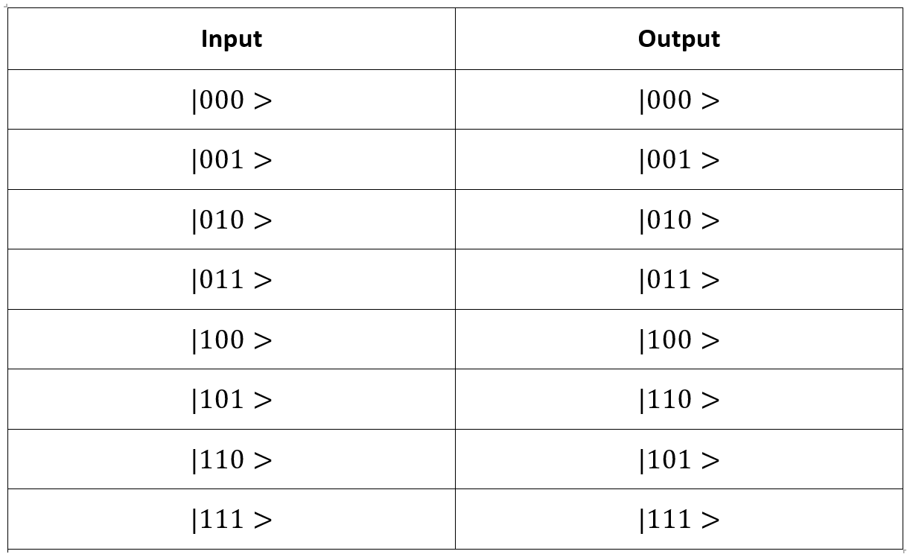
The quantum CSWAP gate – Fredkin gate
The CSWAP or Fredkin gate, as you might have guessed, is a controlled version of the SWAP gate that we have already covered. This gate acts on three qubits.
The first qubit is the control and the other two qubits are swapped whenever the control qubit is set to state|1>.

Slide 15
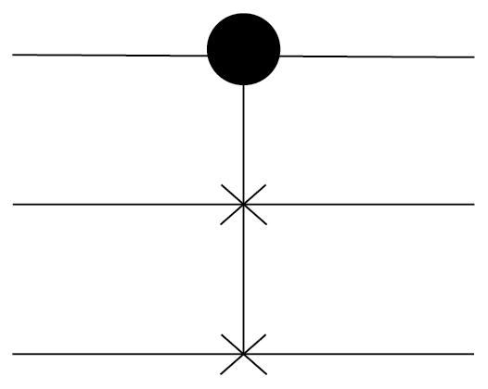
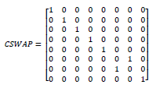
you can see that the first qubit is held as control and the second and third qubits are being swapped.

Slide 16
Quantum teleportation
It is used to transfer a quantum state from one place to another place without the need to travel the space between the source and destination.
Suppose Alice wants to send some information using a quantum state to Bob.
She could send it by copying the quantum state she has, but due to the no-cloning theorem she is unable to copy her state

Slide 17
To begin the teleportation process, consider that Alice and Bob both share a Bell state, which is an example of an entangled state.
There are a total of four kinds of operations that Bob can perform on his qubit to find out the state that Alice has sent to him.
If measured value of a and b is 00, then Bob does nothing.
If measured value a and b is 01, then Bob applies an X gate to his qubit (c qubit).
If measured value a and b is 10, then Bob applies a Z gate to his qubit (c qubit).
If measured a and b is 11, then Bob applies a Z gate and an X gate to his qubit (c qubit).

Slide 18
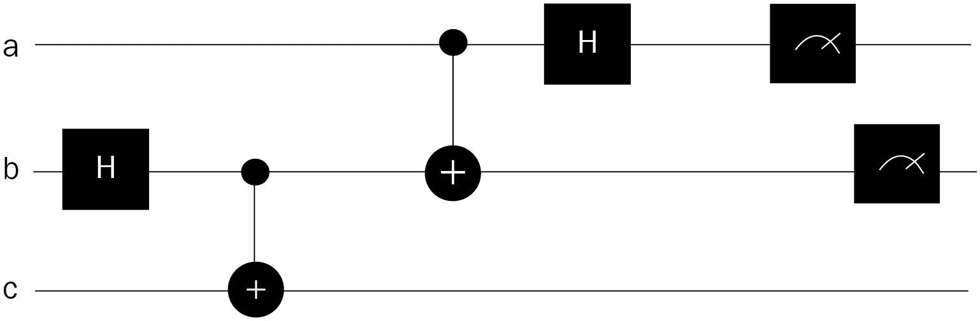
Alice generates an entangled state between the qubits b and c.
After this, Bob undo the operation of Alice by applying a CNOT and Hadamard gate between qubit a and b.
Then Bob makes a measurement and, based on that, applies the operations that have been describe.

Slide 19
Super Dense Coding
In quantum information theory, superdense coding (also referred to as dense coding) is a quantum communication protocol to communicate a number of classical bits of information by only transmitting a smaller number of qubits, under the assumption of sender and receiver pre-sharing an entangled resource.
In quantum teleportation, we saw that two classical bits are used to transfer a quantum state from Alice to Bob.
In superdense coding, we use a single quantum state to send two classical bits.

Slide 20
There are two classical bits, which means a total of 4 combinations.
Now, depending on Alice and what she wants to send to Bob, she will apply one of the following gate operations:
If Alice wants to send 00, then nothing is done.
If Alice wants to send 01, then a Z gate is applied.
If Alice wants to send 10, then an X gate is applied.
If Alice wants to send 11, then ZX is applied.

Slide 21
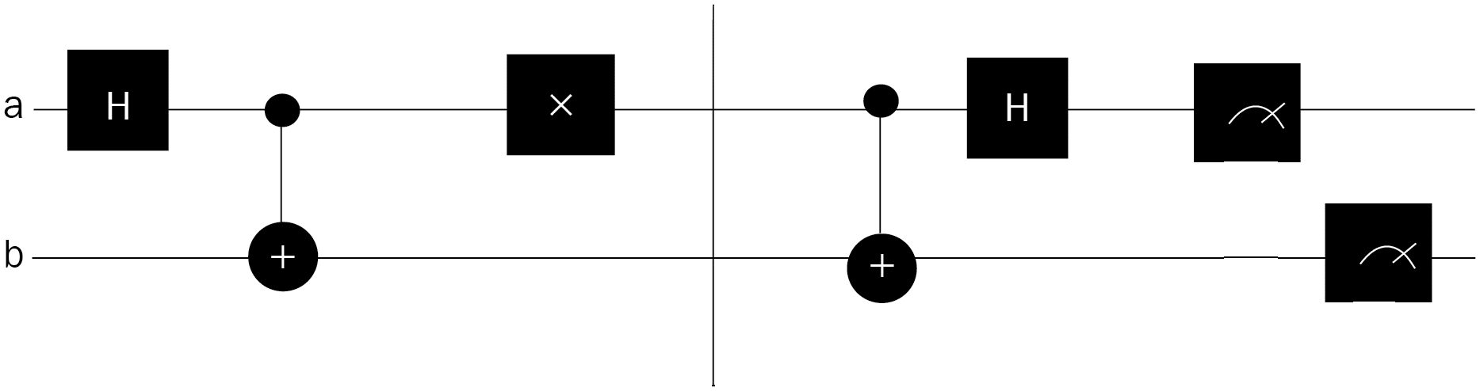
you can see that Alice generates a shared entanglement between qubits a and b and, to encode her secret message, she uses the X gate, which means she is sending value with 10 as information to Bob.
Bob then undoes the operation applied by Alice by applying CNOT and Hadamard operations.

Slide 22
The expected output after the measurement can be summarized as follows:
If the classical bits sent are 00, then the output of the measurement will be |00>.
If the classical bits sent are 01, then the output of the measurement will be |10>.
If the classical bits sent are 10, then the output of the measurement will be |01>.
If the classical bits sent are 11, then the output of the measurement will be –|11>.
The superdense coding technique has immense significance in transmitting or encrypting messages between two parties, and it cannot be intercepted by any other third party.
Superdense coding is therefore like a quantum encrypted coding scheme.

Slide 23
THANK YOU

